Slide 1
Workshop on the Operation of Civil Registration, Vital Statistics and Identity Management Systems for East Asian Countries, 13 – 17 November 2017, Hanoi, Vietnam
Maintenance of civil registration and vital statistics components:
NATIONAL CIVIL REGISTRATION DATABASE OF VIETNAM
Presenter: Lo Thuy Linh, Legal officer
Civil registration Division
Agency for Civil registration, Nationality and Attestation
Ministry of Justice
Email: linhlt@moj.gov.vn

Slide 2
Main ideas
I. Civil registration database
Paper (Civil status books)
e-Civil registration database
Shortcoming and recomendation
II. How to maintain?
Modification of records;
Preservation of stored records;
Training for civil registrar.

Slide 3
I. Civil registration database

Slide 4
Civil registration and vital statistics agencies in Vietnam
MINISTRY OF JUSTICE
(Department of Civil, Nationality, Certification; Department of Financial Planning)
MINISTRY OF FOREIGN AFFAIRS
(Department of Consular
Representative agents)
PROVINCIAL PEOPLE COMMITTEE
(DEPARTMENT OF JUSTICE)
Assisting the provincial People’s Committee in local civil registration and State management, producing vital statistics report
DISTRICT PEOPLE’S COMMITTEE
Department of Justice assists District People’s Committee in civil registration and management, producing vital statistics report
COMMUNE PEOPLE’S COMMITTEE
Justice and Civil officer assist Commune People’s Committee in civil registration and management, producing vital statistics report

Slide 5
Legal documents on CRVS database
Law on Civil status 2014 ;
Decree No. 123/2015/ND-CP (detailed civil registration procedure);
Cicular No. 15/2015/TT-BTP (including regulations on the forms of civil status books and certificate (birth, marriage, death…etc);
Join Cicular No. 02/2016/TTLT-BNG-BTP (civil registration procedure in Representative agents).
Decision of Minister of MOJ on Project “National electronic civil status database” (No. 2173/QD-BTP dated 11 December 2015)

Slide 6
Roles of Civil registration database
Art. 57 (Law on Civil status):
1. The civil status database is a national asset storing all civil status information of every individual, serving as a basis for protecting lawful rights and interests of individuals, and serving the information reference, management, and policymaking for national socio-economic development.
2. The civil status database includes civil status books and electronic civil status database for use as a basis for the issue of civil status extract copies.

Slide 7
National Civil registration database
Civil status books:
Paper
Be saved forever under the Law;
Including individuals’ information;
Have some types of civil satus books depending on the kinds of civil registration (birth, marriage, death…etc);
Can be changed/edited under the Civil status Law
e-Civil registration database (e-CRD):
Computer files on civil registration software;
Be saved forever;
Started from 01 Jan. 2016 (Law on civil status tooks effect);
Have been pilotted in 4 big cities in Vietnam: Hanoi, Haiphong, Danang and Hochiminh city in 2016.
Now is 17 cities and provinces; by the end of 2017: 28 cities and provinces implementing software.
Can be changed/edited by civil registrar or MOJ (IT department).

Slide 8
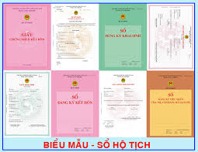
Forms of Civil status book and certificate
Notes:
COVER OF CIVIL STATUS BOOKS

Slide 9
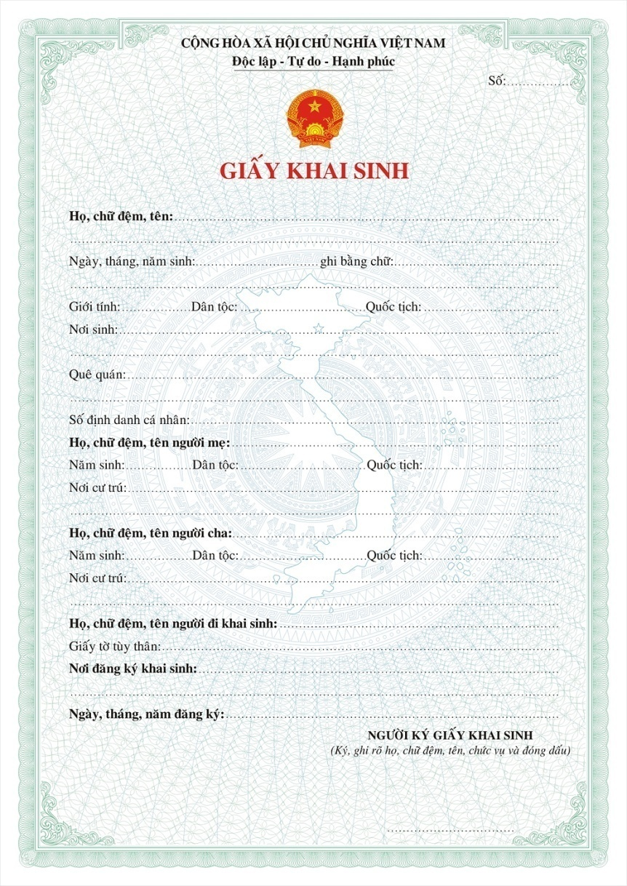
Birth certificate

Slide 10
Content of Birth registration book
Person is registered for birth Name: …………………………….………………..…….. …………………………………….………………..………………… Date of birth: …../…./…..… in words: …………….……………… …………………………………….………………..………………… …………………………………….………………..………………… Sex: …………… Ethnicity: ……………Nationality: …………… Place of birth: ………………………….………………..………………… ……………………….………………..………………………………. Hometown: ……………………….………………..……………...… PIN: ……..………….....................................……… Name of mother: ………………..…….………………..…….. ……………………….………………..……………………………… Year of birth: ………….. Ethnicity: ……………Nationality: ……… Place of residence:……………….………………..………………… ……………………….………………..……………………………… Name of father: ………………..…….………………..…….. ……………………….………………..……………………………… Year of birth: ………….. Ethnicity: ……………Nationality: ……… Place of residence:……………….………………..………………… Name of person who conducted birth registration: …………… ……………………….………………..……………………………… ID information: ……………………..…………………………….… Full name, position of person signing the birth certificate /Extract in the birth register: ………………………….……………. …................………………………………….……………………..…. ……………………….………………..……………………………… Name of person conducting birth registration Civil registrar (Signature, full name) (Signature, full name) ………………. ………………. | Ontime: Late registration: Re-registration: Child whose parents haven’t been identified : Abandoned child: Record the birth in civil status books: Notes⁽⁶⁾ …….……………….. …….……………….. …….……………….. …….……………….. …….……………….. …….……………….. …….……………….. …….……………….. …….……………….. …….……………….. …….……………….. …….……………….. …….……………….. …….……………….. …….……………….. …….……………….. …….……………….. …….……………….. …….……………….. …….……………….. …….……………….. …….……………….. …….……………….. …….……………….. …….……………….. …….……………….. …….……………….. …….……………….. …….………………..
Page No: 01

Slide 11
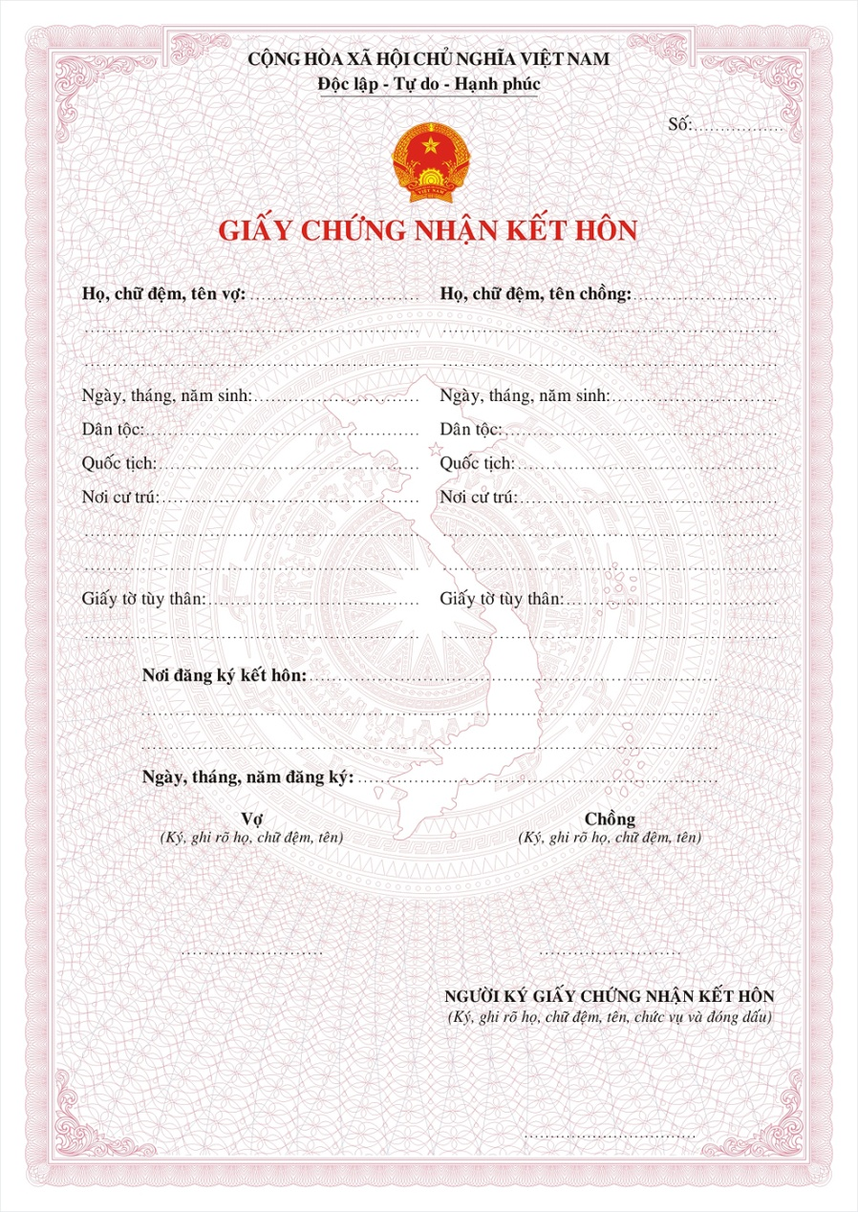
Marriage certificate

Slide 12
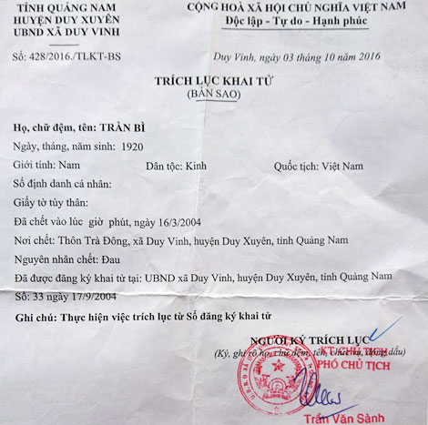
Death certificate (includes CoD according to death notification)

Slide 13
e-CRD in Vietnam

Slide 14
e-CRD in Vietnam
1. National e-CRD or General Information System on Civil registration and management is a comprehensive information system which will allow citizens, relevant agencies, organizations, registrars, civil status managers, etc., to access information, and register civic status online, to create an e-CRD; to handle information on professional activities according to the Law on Civil status, carry out statistical reporting and monitoring of civil status changes according to administrative unit decentralization as well as nationwide.
2. The system is based on 04 information systems and software components including:
2.1. Civil status management information system for CRD management agencies including MOJ to provide a tool to assist these agencies in the management of population registration data, civil status data changes for monitoring, statistics, reporting and Socio-economic development policy making ... within the scope of their management;
2.2. Civil registration software; Online civil registration system for all civil registration agencies to ensure the connectivity and sharing of information under the Civil Status Law;
2.3. Centralized User Management Software for Department of Justice at provincial-level and Consular Department (MOFA) in the management and monitoring of IT application activities at the civil registration agencies under their management.

Slide 15
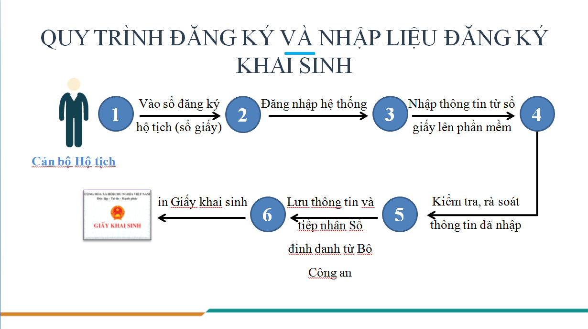

Slide 16
The process of registering and importing birth registration data:
Civil registrar write individual’s information in civil status books (paper books);
Sign in the e-CR system;
Enter individual’s information from the CR book into the software;
Checking the entered information;
Record information and receive personal identification numbers (PIN) from the Ministry of Public Security;
Printing birth certificates and granting them to birth registration applicants

Slide 17
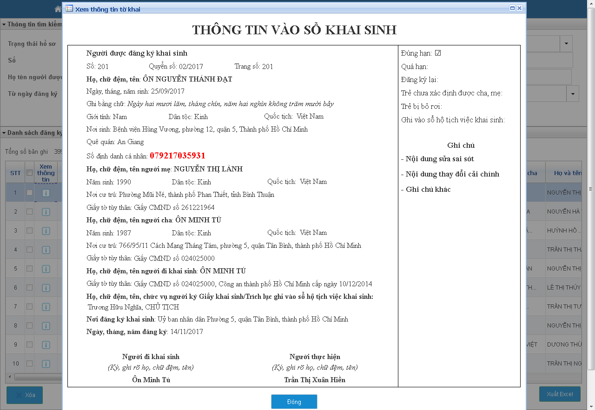

Slide 18
Result of issuing PIN for children through e-CR software:
From 01 Jan. 2016 to 09 October 2017, the system has recorded 765,280 cases of children are Vietnamese citizens under the age of 14, registered first birth is granted Personal Identification Number (from 01 Jan. 2017 to 09 Oct. 2017 is 449,167 cases).
Video on “What is PIN?” (in Vienamese):
https://news.zing.vn/video-so-dinh-danh-ca-nhan-la-gi-post794405.html

Slide 19
Shortcoming:
Due to the limited IT infrastructure of the Ministry of Justice as well as financial resources, e-CRD has been facing many dificulties to meet the requirements of accessing and archiving data of all 63 provinces, only implement step by step (Only the birth registration software can be connected with the National database on population of MPS, to input data and grant PIN for children (be written in birth certificate) from 01 Jan. 2016);
Cooperation mechanism between 2 ministries (MOJ & MPS) in the developing 2 databases;
- Limited infrastructure in local civil registration agencies: many localities have no electricity, Internet, no PC, so it is difficult to deploy e-CR system.

Slide 20
II. How to maintain CRVS components?

Slide 21
2.1. Modification of records
* Paper-based records: Can be changed, edited, updated according to the Law on Civil status:
Art. 4:
10. Civil status change means a competent state agency registering changes in civil status information of an individual when there is a plausible reason in accordance with the civil law or changes in information about parents in the registered birth declaration contents in accordance with law;
12. Civil status correction means a competent state agency correcting civil status information of an individual when there is an error in the civil status registration;
13. Civil status supplementation means a competent state agency updating missing civil status information for a registered individual.

Slide 22
2.1. Modification of records (Cont.)
Article 26. Scope of civil status change
1. Change of family name, middle name and first name of individuals in birth registration contents when there are grounds as prescribed by the civil law.
2. Change of information about parents in birth registration contents after being adopted as children in accordance with the Law on Adoption.
Art. 58.
The civil status book serves as a legal basis for making, upgrading and adjusting civil status information of individuals in the electronic civil status database.

Slide 23
2.1. Modification of records (Cont.)
*Computer files on the e-CRD: Can be changed, edited, updated by civil registrar according to the Law on Civil status similar to paper-based records.
Except cases including: change information related to sex, date of birth, authority or belong to illegal civil registration cases => must submit to MOJ (IT Department)

Slide 24
2.1. Modification of records (Cont.)
Article 60. Update and adjustment of personal civil status information in the electronic civil status database
1. Civil status events of individuals, immediately after being registered in the civil status book, shall be promptly, fully and accurately updated in the electronic civil status database. Civil status registration agencies shall take responsibility for all civil status information updated in the electronic civil status database.
2. In case information in the electronic civil status database or national population database is different from information in civil status books, it shall be adjusted to match civil status books

Slide 25
2.2. Preservation of stored records
Civil status books:
e-CRD
Article 58. Civil status books
Each type of civil status matter shall be recorded in one book with its pages appended with an overlapping seal on the edges of every two pages. Civil status books shall be preserved permanently in accordance with law.
The closing of a civil status book shall be made in the last day of a year. When closing a civil status book, the total number of pages and total number of civil status events already registered shall be clearly written; the head of the civil status registration agency shall sign and a seal shall be appended.
Papers and articles or other evidences submitted upon civil status registration shall be archived and preserved in accordance with the law on archives.
The civil status registration agency shall archive and preserve civil status books, papers, articles or other evidences related to civil status registration.
At the present, all e-CR data of 17 provinces which implement CR software will be saved in the Data Center, IT Department, Ministry of Justice.
Very easy to conduct vital statistics (daily, monthly, annual);
Meet international standards.

Slide 26
Percent of children under 1 year old having their birth registered by place of usual residence (urban and rural) of mother in 2016
(From e-CR database in 2016)
City | Children under 1 year old having their birth register by place of usual residence of mother in 2016
 | Total |  | Urban |  | Rural
 | Number | Percent | Number | Percent | Number | Percent
Ha Noi | 117,662 | 100 | 47,227 | 40.1 | 70,435 | 59.9
Ha Phong | 27,748 | 100 | 11,101 | 40.0 | 16,647 | 60.0
Da Nang | 14,852 | 100 | 12,578 | 84.7 | 2,274 | 15.3
Ho Chi Minh | 41,632 | 100 | 39,358 | 94.5 | 2,274 | 5.5
Total | 201,894 | 100 | 99,022 | 49.0 | 102,872 | 51.0

Slide 27
Distribution of registered live births by sex in the four largest cities in 2016
(From e-CR database in 2016)
City | Children under 1 year old having their birth registered |  |  |  |  |  | Sex ratio
 | Total |  | Male |  | Female
 | Number | Percent | Number | Percent | Number | Percent
Ha Noi | 125.626 | 100 | 67.052 | 53.4 | 58.574 | 46.6 | 114.0
Ha Phong | 30.520 | 100 | 15.949 | 52.3 | 14.571 | 47.7 | 109.5
Da Nang | 17.047 | 100 | 8.821 | 51.7 | 8.226 | 48.3 | 107.2
Ho Chi Minh | 89.001 | 100 | 46.011 | 51.7 | 42.990 | 48.3 | 107.0
Total | 262.194 | 100 | 137.833 | 52.6 | 124.361 | 47.4 | 110.8

Slide 28
Training for Civil registrar
Every year;
3 levels:
+ Central-level (MOJ supported by UNICEF, WHO);
+ Province-level (Department of Justice);
+District-level (Justice Division).
Based on training materials;
MOJ has been preparing to produce handbook for civil registrar in 2018 to improve Civil registration capacity for them as well as implement CRVS Programme.

Slide 29
Development orientation of CRVS system
- Strengthening and improving the CR capacity of civil registrar;
- To study the renewal of the system of civil status registration, management and statistics agencies (professional registration offices)
- In 2018 deploys e-birth registration system and connects the National on Population database for all 28 provinces, 2019 for about 50 provinces.
- Deploy linkage of sectoral data systems to use the National on Population database, use ID card, PIN number from 2020.

Slide 30
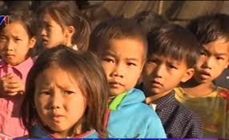
Thank you!

